Slide 1
KPMG – CAPSTONE PROJECT E- Commerce analytics
Using unsupervised machine learning
Batch - DSP 35
Arjun.S
Divakaran.R
Jaya Dhanush
Harish Kumar
Arshad

Slide 2
Slide No. | Contents | Slide No. | Contents
1 | Title | 15 | Most valuable customers
2 | Table of contents | 16 | Least valuable customers
3 | Objective and our understandings | 17 | Monetary values for blank customer IDs
4 | Raw Data | 18 | Building unsupervised machine learning model
5 | Understanding the data in terms of business | 19 | K-Means clustering
6 | EDA- Exploratory Data Analysis | 20 | Results of K-Means clustering
7 | Data Cleaning and Data Preparation | 21 | Actionable marketing strategies Based on K-Means clustering
8 | RFM (Recency, Frequency and Monetary values) | 22 | Hierarchical clustering
9 | RFM Formulas | 23 | Clusters formed using hierarchical clustering
10 | Recency calculation | 24 | Results of hierarchical clustering
11 | Recency scores | 25 | Actionable marketing strategies based on hierarchical clustering
12 | Frequency Calculation | 26 | Observations
13 | Frequency scores | 27 | K- Prototype clustering
14 | Monetary value score | 28 | Annexure

Slide 3
OUR UNDERSTANDINGS: 1. Our data set does not have Dependent and Independent variables. 2. To achieve our objectives, we must segment the customers into different clusters based on their RFM scores. 3. The variables used for RFM scores are: Recency - Date of Purchase, Customer ID Frequency - Invoice No, Date of Purchase Monetary values - Customer ID, Mean value of Sum of total purchases made by unique customer ID. 4. Unsupervised machine learning algorithms are used to cluster the customers. 5. Our date of reference is 12/20/2017
OBJECTIVE:
To cluster the E- commerce customers based on their RFM scores using unsupervised machine learning algorithm.

Slide 4
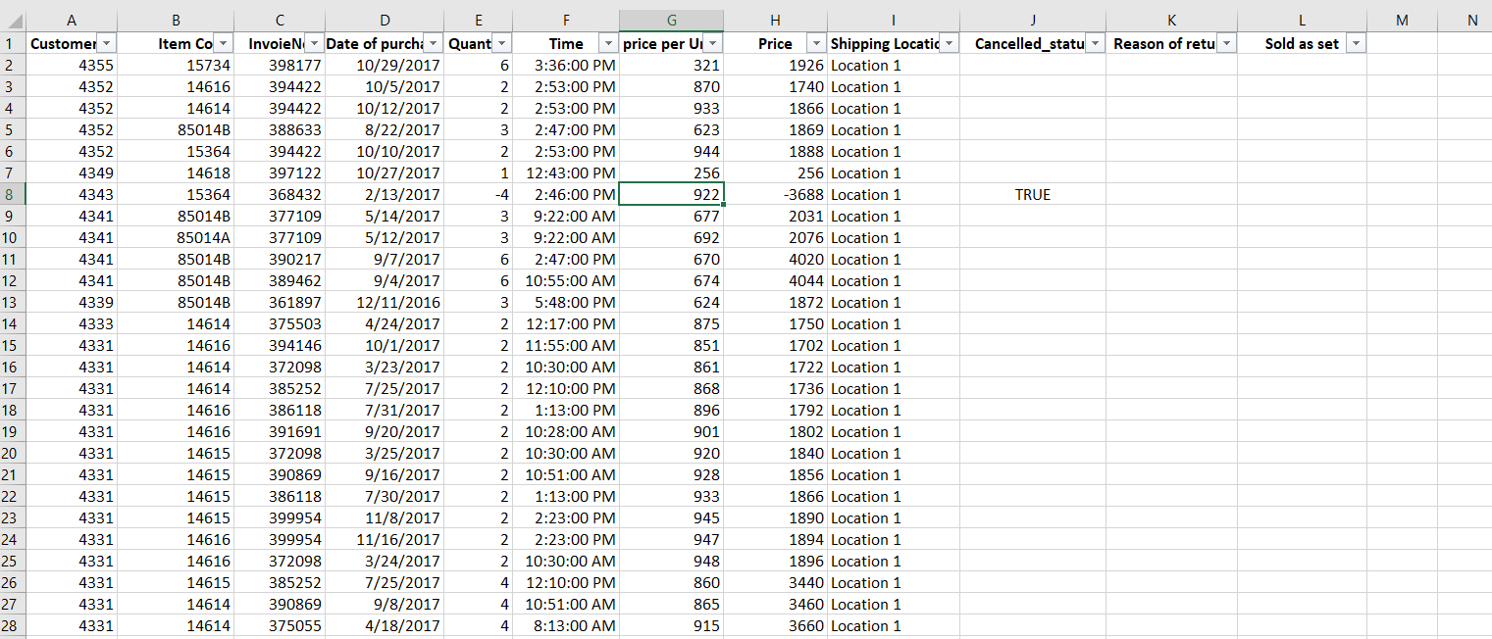
RAW DATA: Segmenting the below mentioned customers into clusters based on our client’s attributes such as Recency, Frequency, Monetary values of the transactions made.

Slide 5
1. Business is always an outcome of supply and demand. Hence, it is necessary for firms to understand their customers and decipher their wants and needs. 2. A machine learning model can help us understand customers and their purchase pattern, organizations can make critical business decisions to attract more customers and serve them better, thereby gaining a competitive advantage. 3. RFM analysis, is a widely known standard technique used to evaluate customer lifetime value, especially in the E- Commerce industry. 4. Based on the customer clusters that we provide, the marketing team will provide them with offers which are based on their own characteristics.
UNDERSTANDING THE DATA IN TERMS OF BUSINESS:

Slide 6
1. Handling missing values - Sales with blank customer ID were filtered out. 2. Handling negative values - Negative price values were removed. 3. Counting the total number of unique customer ID. 4. Variable column named Days since is created to calculate recency. 5. Variable column named Year Month is created to avoid overlapping of data as the month ‘December’ is repeated twice on 2016 and 2017. 6. The year month variable that we created is used to represent the total frequency and monetary values of the sales made in every month in bar graph.
EDA – Exploratory Data Analysis

Slide 7
1. Variables “Cancelled status”, “Reason of return”, “Sold as set” has more than 25% of its data missing. So, we are going to remove these entire variable columns. 2. Number of unique customer IDs - 4324
DATA CLEANING and DATA PREPERATION:
Variables | Total Count | Missing values
Customer ID | 396006 | 132470
Cancelled status | 528476 | 528476
Reason of return | 528476 | 528476
Sold as set | 528476 | 528476

Slide 8
Recency is the number of days since last purchase was made . by a unique customer ID. FREQUENCY is the total number of transactions made by the unique customer ID. MONETARY VALUE is the total amount that the customer has spent across all transactions.
RFM (RECENCY, FREQUENCY AND MONETARY VALUES)

Slide 9
RECENCY = (Reference date - Most recent date of purchase by customer ID’s. ) FREQUENCY = (Number of purchases made by a customer ID’s with unique invoice number.) MONETARY = (Mean value of the total price / Total number of sales transactions.)
RFM FORMULAS:

Slide 10
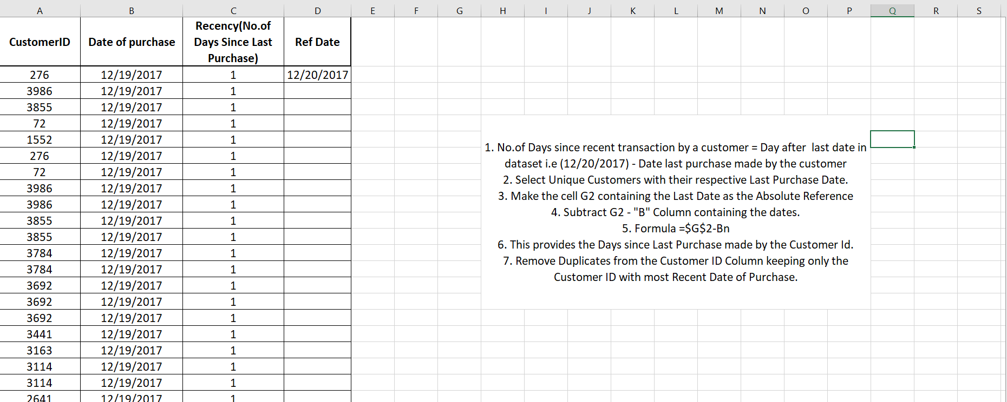
1. Recency is calculated using the formula, Reference date - Most recent date of purchase made by customer IDs. 2. This helps to determine the Days since Last Purchase made by the Customer Id. 3. The date of reference is 12/20/2017.
RECENCY CALCULATION:

Slide 11
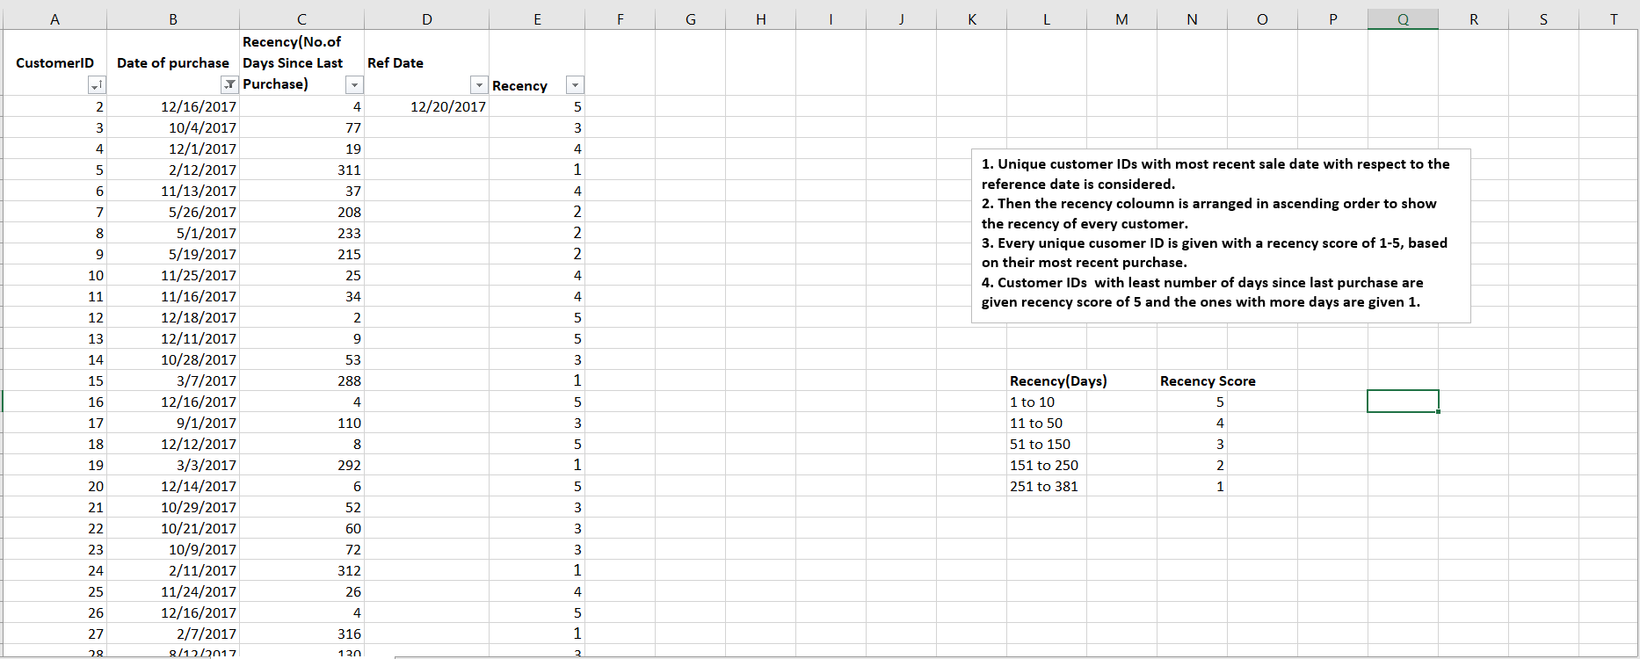
Most recent Purchases are given the Highest recency score of “5” Least recent Purchases are given the Lowest recency score of “1”
RECENCY SCORE:

Slide 12
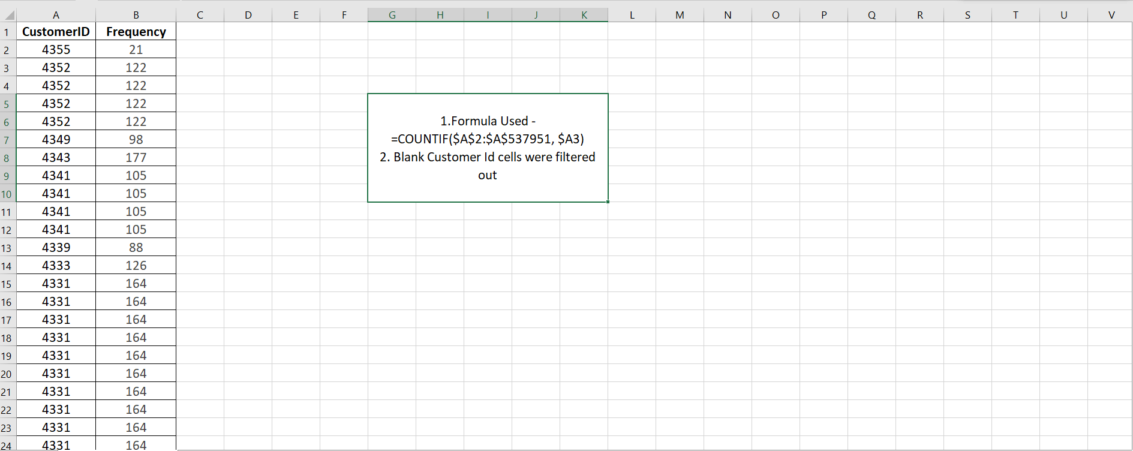
1. Frequency is calculated by taking the unique customer IDs which made higher number of sales in the given period of time with Unique Invoice Number. 2. Pivot Table provides the Customer ID with their respective Frequency and F Score.
FREQUENCY CALCULATION:

Slide 13
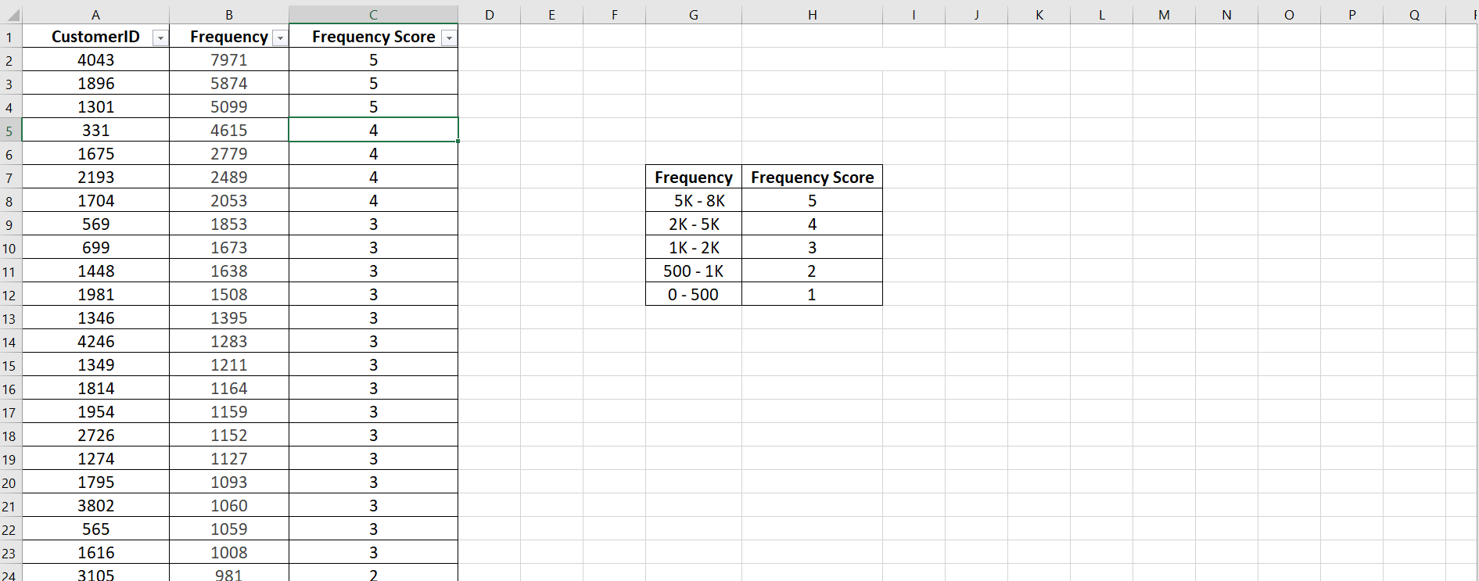
1. A score of 1-5 is given to unique customer IDs, the highest frequency values with 5 and the lowest with 1. 2. This helps us to prioritize the customers and increase the purchases made by them by planning strategies based on their nature of purchase.
FREQUENCY SCORE:

Slide 14
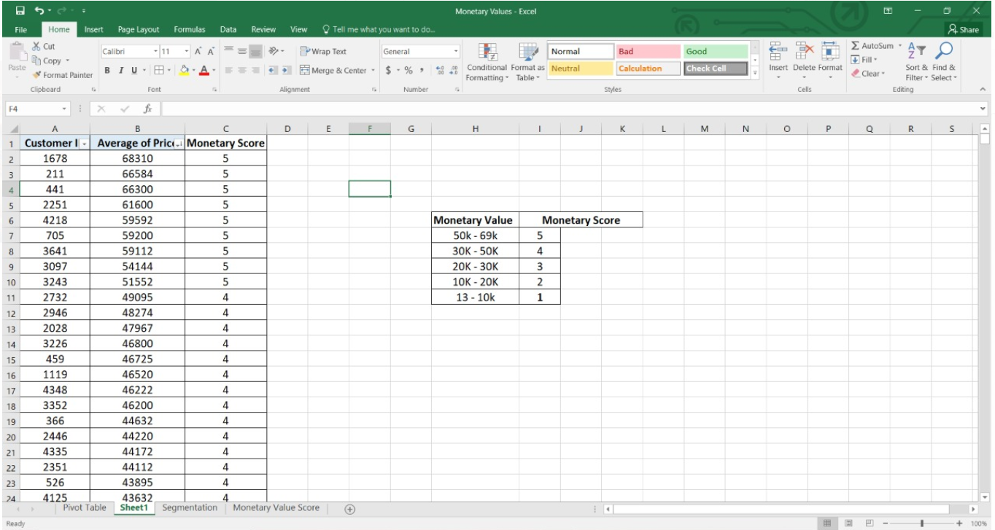
1. Monetary score is given to customer IDs with highest to lowest scores ranging from 5-1. 2. Customer ID’s with highest monetary values are given 5 score and lowest with 1.
MONETARY VALUE SCORE :

Slide 15
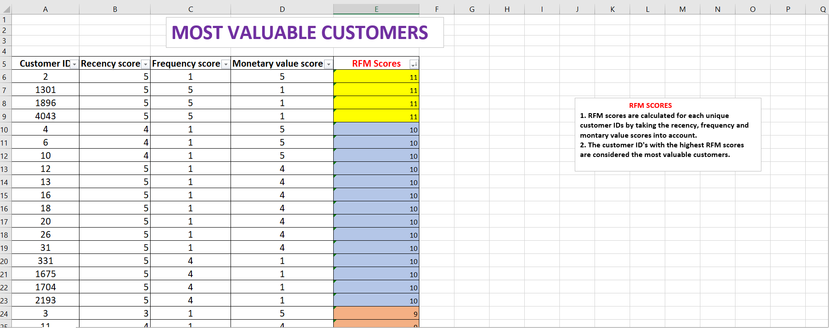
1. Most valuable customers are Customers with the highest RFM scores. 2. They have Purchased Recently, More Frequently and for High Monetary Values.
MOST VALUABLE CUSTOMERS:

Slide 16
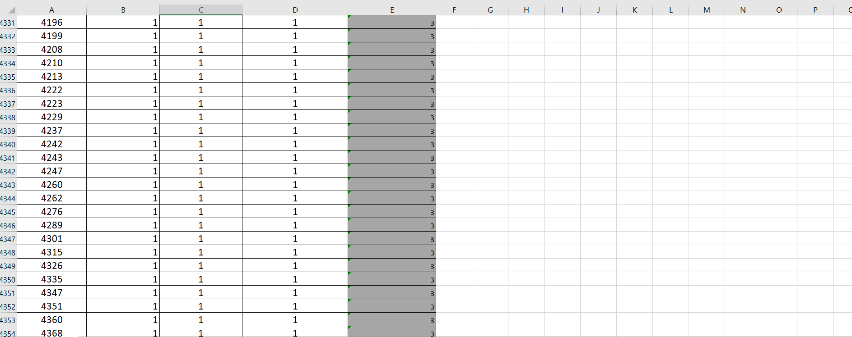
1. Least valuable customers are Customers with the least RFM scores -3. 2. Their purchases are not recent, frequency is very less and monetary value is very low.
LEAST VALUABLE CUSTOMERS:

Slide 17
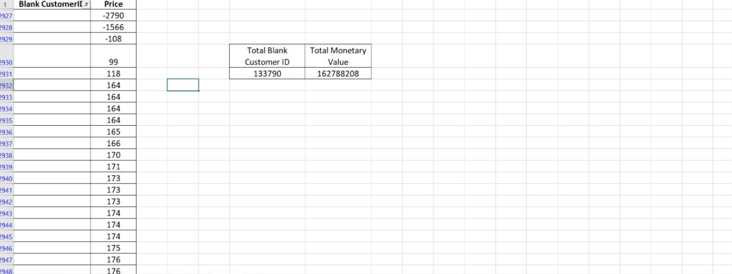
1. Total monetary values of transactions made by blank customer ID’s is substantial, hence they cannot be neglected. 2. Hence we have to find a way to retain these customers and also to get them to register. 3. Offers can be provided to new registering customers in order to assign them an unique customer ID. 4. This helps us to calculate their RFM scores in future.
MONETARY VALUES FOR BLANK CUSTOMER ID’s:

Slide 18
K- MEANS CLUSTERING: 1. Finding the K value by using the elbow method in the significant variables. 2. Building an unsupervised model to cluster the entire customers into the K value. 3. Visualizing the clusters formed to show the segregation that was done by the unsupervised machine learning algorithm.
Building Unsupervised machine learning model:

Slide 19
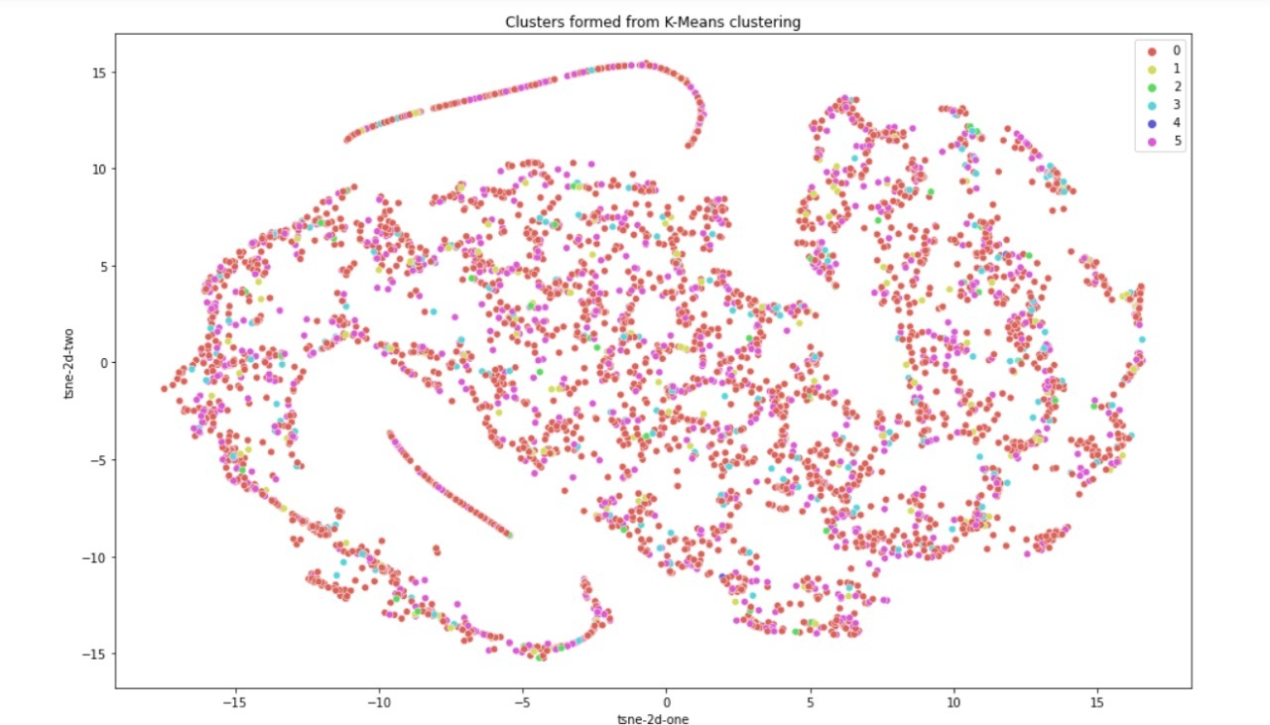
K-MEANS CLUSTERING:

Slide 20
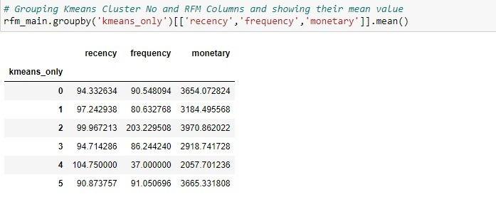
RESULTS OF K-MEANS CLUSTERING:
CLUSTERS | RFM SCORES | LABELS(CHARACTERISTICS)
5 | 6,5,5 | Customers who have purchased very recently and with high frequency and monetary values.
4 | 1,1,1 | Customers who have purchased very long ago, rarely purchases for less monetary values.
3 | 4,3,2 | Customers who have purchased recently, has moderate frequency and for low monetary vales.
2 | 2,6,6 | Customers who have purchased long ago, very frequently, for very high monetary values.
1 | 3,2,3 | Customers who have purchased not so long ago,, less frequently, for average monetary values.
0 | 5,4,4 | Customers who have purchased recently and with average frequency and monetary values.

Slide 21
ACTIONABLE MARKETING STRATEGIES BASED ON K-MEANS CLUSTER:
CLUSTERS | CUSTOMER TYPE | ACTIONABLE MARKETING STRATEGIES
5 | Champion Customers (6,5,5) | Reward them. Can be early adopted for new products. Will promote your brand.
4 | Least valuable Customers (1,1,1 ) | Revive interest with reach out campaign. Ignore otherwise.
3 | Promising Customers (4,3,2) | Create brand awareness. Offer free trials.
2 | At Risk Customers (2,6,6) | Send personalized Emails to reconnect, offer renewals, provide helpful resources.
1 | Customers needing attention (3,2,3) | Make limited time offers, recommend based on past purchases, Reactivate them.
0 | Loyal Customers (5,4,4) | Upsell higher value product, ask for review, engage them.

Slide 22
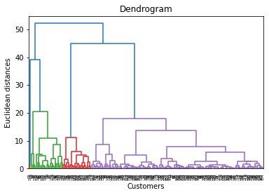
1. Hierarchical cluster does not require to specify the number of clusters before hand. 2. Types : - Agglomerative method - Divisive method
Hierarchical Clustering:

Slide 23
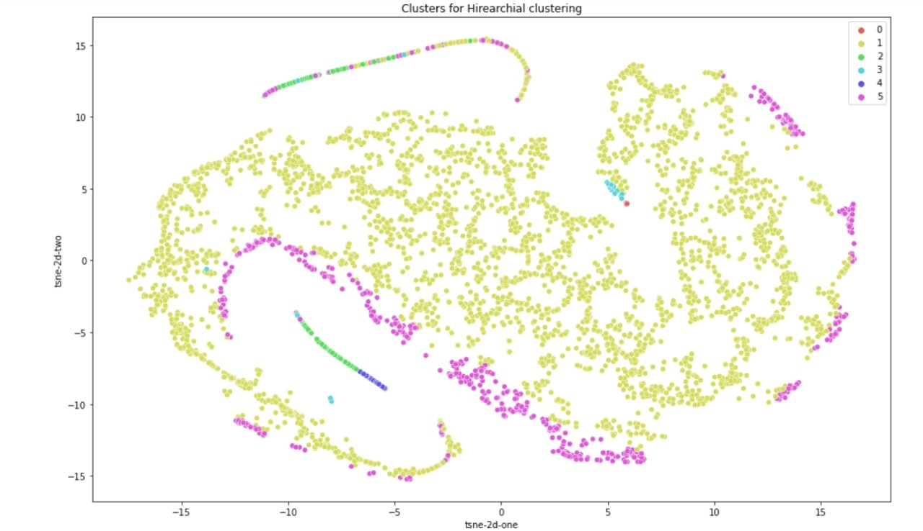
CLUSTERS FORMED USING HIERARCHIAL CLUSTERING:

Slide 24
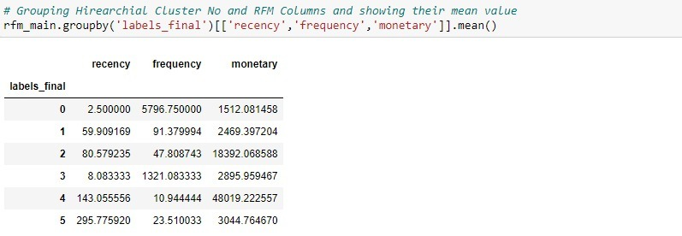
RESULTS OF HIERARCHIAL CLUSTERING:
CLUSTERS | RFM SCORES | LABELS(CHARACTERISTICS)
5 | (6,6,1) | Customers who have purchased recently, frequently but for low monetary values.
4 | (4,4,2) | Customers who have purchased 2 months ago, purchases frequently for low monetary values.
3 | (3,3,5) | Customers who have purchased 3 months ago, on repeated occasions, for high monetary values.
2 | (5,5,3) | Customers who have purchased recently, frequently but for lower monetary values.
1 | (2,1,6) | Customer who have purchased 5 months ago, rarely purchases but for higher monetary values.
0 | (1,2,4) | Customer who have purchased 9 months ago, rarely purchases but for average monetary values.

Slide 25
ACTIONABLE MARKETING STRATEGIES BASED ON HIERARCHIAL CLUSTERING:
CLUSTERS | CUSTOMERS TYPE | ACTIONABLE MARKETING STRATEGIES
5 | Champion Customers (6,6,1) | Offer membership/ Loyalty program, recommend other products.
4 | Promising Customers (4,4,2) | Create brand awareness. Offer free trials.
3 | Customers needing attention (3,3,5) | Win them back via renewals or newer products, don’t lose them to competition, talk to them.
2 | Loyal Customers (5,5,3) | Upsell higher value product, ask for review, engage them.
1 | At Risk Customers (2,1,6) | Send personalized Emails to reconnect, offer renewals, provide helpful resources.
0 | Least valuable Customers (1,2,4) | Share valuable resources, recommend popular products/ renewals at discount, reconnect with them.

Slide 26
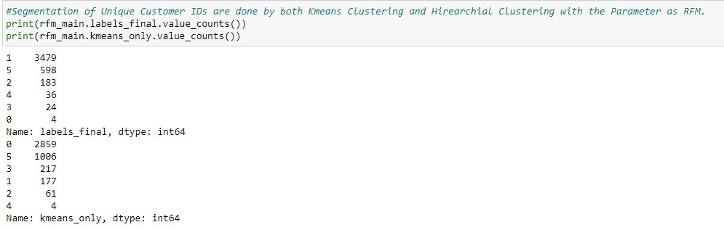
1. Hierarchical clustering is doing a good job in finding clusters with varying attributes for customers, however the cluster sizes are imbalanced. 2. K-means clustering is also doing a good job in finding varying clusters of customers, with balanced cluster sizes as well.
Observations:

Slide 27
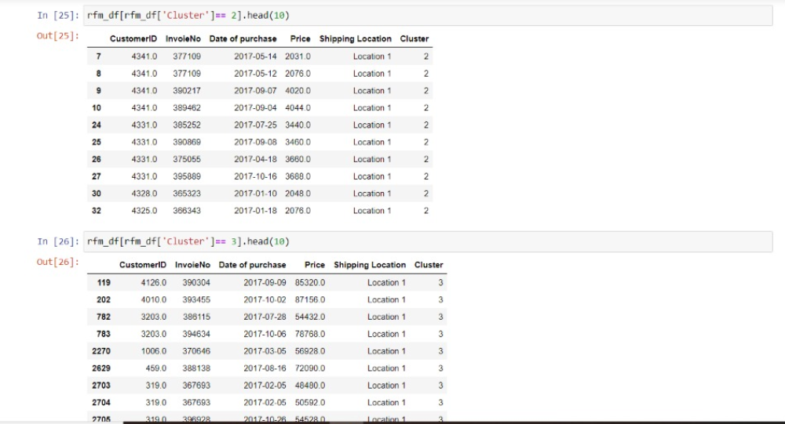
K- PROTOTYPE CLUSTERING:
1. K-Prototype is suitable for Clustering Data with both Continuous and Categorical Variables.
2. K-Mode replaces Mean of Clusters with Mode Value.

Slide 28
https://drive.google.com/drive/folders/1jWMgEP3V1fITEAZTimisi3eA5IFdJ4hZ?usp=sharing The above link contains, 1. Raw data 2. Manual segmentation using excel 3. Python code containing RFM clustering
Annexure:

Slide 29

.
THANK YOU !

